Slide 1



19-22 March 2026 Yashobhoomi, Dwarka
New Delhi, India
ELECTRIFYING GROWTH.
EMPOWERING SUSTAINABILITY.
CONNECTING GLOBALLY.

Slide 2






ABOUT BHARAT ELECTRICITY SUMMIT
OVERVIEW
Bharat Electricity Summit 2026 is India’s premier platform for the power and electricity sector.
Held under the patronage of the Ministry of Power, Government of India, the event is scheduled to take place from 19-22 March 2026 at Yashobhoomi, Dwarka, New Delhi.
EXHIBITION
STRATEGIC CONFERENCE
TECHNICAL CONFERENCE
Showcasing innovations, technologies and solutions shaping the future of the global power supply chain.
Uniting global ministers, CEOs and thought leaders to shape a secure, sustainable power agenda.
Bringing together technical experts to share innovations and solutions advancing power infrastructure and operations.
BUYER-SELLER MEET
LEADERSHIP ROUNDTABLES
SPECIAL FEATURES
Pre-arranged meetings connect key buyers with solution providers to unlock opportunities.
Invite-only sessions convening leaders for high-impact, closed-door strategic dialogue.
Showcasing innovations from startups, next-gen technologies, women leaders and young professionals shaping the future of electricity.

Slide 3

ABOUT BHARAT ELECTRICITY SUMMIT
THE SUMMIT IS DEDICATED TO:
EVENT IN NUMBERS
 | Convening global policymakers, CEOs, government leaders, electricity experts, investors, regulators, innovators, suppliers, and solution providers.
 | Driving progress across the entire electricity value chain—from generation and transmission to distribution, storage, and smart consumption.
 | Serving as a global platform to align national energy priorities with international best practices.
 | Fostering cross-border collaborations and mobilising investments to accelerate clean electricity deployment.
 | Combining a vibrant global exhibition, strategic and technical conference and high-level networking to create unparalleled opportunities for innovation, policy dialogue, and business growth.
 | Positioning India’s leadership, scale, and innovation in renewables, storage, and power infrastructure to deliver solutions with global impact.
25,000+
Exhibition Attendees
500+
Exhibiting Companies
1,000+
Conference Delegates
300+
Conference Speakers
50+
Conference Sessions

Slide 4





PRINCIPAL PARTNERS
COLLABORATE WITH INDIA’S STRATEGIC POWER COMPANIES
Power Grid Corporation of India Limited (POWERGRID), is a Public Sector Enterprise under the Government of India. With its standing as one of the largest power transmission utilities in the world, POWERGRID has developed expertise across power transmission, sub-transmission systems, distribution management, load dispatch and communications both within India and internationally while also extending specialised consultancy services to numerous global clients.
Incorporated on 23rd October 1989 under the Companies Act, 1956, POWERGRID is India’s largest electric power transmission utility and has also established a strong global presence across more than 25 countries.
NTPC Ltd is India’s largest integrated power utility, contributing nearly one-fourth of the nation’s electricity requirements. The company has an installed capacity of over 84 GW, with an additional 30.90 GW under construction, including 13.8 GW of renewable energy projects. Aligned with India’s Net Zero ambitions, NTPC is committed to achieving 60 GW of renewable energy capacity by 2032.
With a diversified generation portfolio spanning thermal, hydro, solar, and wind power, NTPC is dedicated to delivering reliable, affordable, and sustainable electricity. Beyond power generation, NTPC is expanding into emerging business areas such as e-mobility, battery energy storage, pumped hydro storage, waste-to-energy, nuclear power, and green hydrogen, reinforcing its commitment to building a cleaner and greener future for the nation.
Power Finance Corporation Limited (PFC), a Schedule-A Maharatna CPSE under the Ministry of Power, is India’s largest government-owned NBFC. Since our inception in 1986, we have been a key enabler of the country’s power sector growth, offering a range of financing solutions tailored to generation, transmission and distribution needs.
Our impact goes beyond numbers. We have supported around 60 GW of renewable energy capacity - nearly 25% of India’s non-fossil fuel installed base - making us the largest renewable energy financer in the country.
Our product portfolio includes rupee term loans, short-term funding, lease financing, and transitional support. Expanding beyond power, we now finance projects in e-mobility, charging infrastructure, roads, ports, metro rail, and smart cities.
REC Limited has played a pivotal role in shaping India’s power sector landscape. Established in 1969 with the primary objective of electrifying rural India, REC has evolved into a leading NBFC that finances the entire power sector value chain—generation, transmission, distribution, and renewable energy. Today, as India stands at the threshold of an energy transition aimed at significantly increasing green energy adoption and achieving net-zero emissions by 2070, REC continues to be a key enabler in this national mission.
NHPC Limited is India's premier green energy NAVRATNA enterprise under the Ministry of Power, Government of India. NHPC generates clean, renewable energy with a focus on hydro, solar and wind power. With an installed capacity of 8332.90, NHPC is constructing projects totaling 9704 MW and it spearheads around 60% of all hydro projects under construction in India. NHPC is aiming total capacity of 23000 MW by 2032 and 50000 MW by 2047. NHPC has an authorized share capital of ₹17,500 crore and an investment base (Assets) of ₹93,570 Crore (standalone) as on 30.09.2025. NHPC is committed to India's energy security and also contributes to its socio-economic development through CSR.

Slide 5
INDIA MARKET
A HIGH-GROWTH MARKET WITH GROWING POTENTIAL
US$ 68.69 BN
Across 382 opportunities in transmission and distribution
US$ 342.98 BN
Across 638 opportunities in electricity generation
US$ 35.14 BN
Across 111 opportunities in energy storage
US$ 16TN
Energy consumption
India is firmly on course to become a US$30 trillion economy by 2047, driven by a bold national vision and the transformative Viksit Bharat mission. At the core of this journey is the transformation of India’s electricity sector — a strategic driver of inclusive growth, industrial competitiveness and long-term energy security.
 | Rapid evolution driven by investments in clean energy, grid infrastructure and advanced technologies.
 | India’s installed capacity exceeds 500 GW, with renewables, hydro and nuclear contributing over 51%.
 | Integrated digital efforts are accelerating India’s clean electricity transition.
 | Adoption of advanced technologies to enhance operational efficiency and system resilience.
 | Regulatory reforms and policy initiatives aimed at market efficiency and private sector participation.
 | Initiatives to improve access and inclusivity in electricity provision across urban and rural areas.
 | Energy security is driven by national missions supporting renewable adoption, grid stability and a self-reliant, low-carbon electricity future.
 | Nationwide electrification initiatives are expanding reliable power access to underserved regions, supporting economic and social development.
Source: *India Investment Grid (IIG)

Slide 6
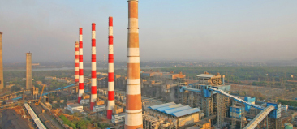
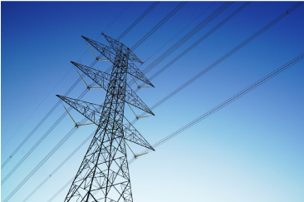
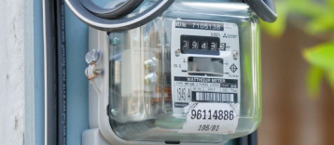
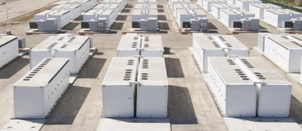

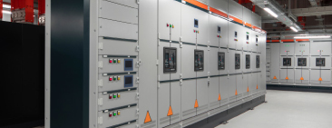


SHOWCASING THE ENTIRE POWER AND ELECTRICITY
VALUE CHAIN
POWER GENERATION TECHNOLOGY
POWER TRANSMISSION SYSTEMS
POWER DISTRIBUTION & CONTROL
ENERGY STORAGE & BATTERY TECH
Manufacturers and solution providers of existing and emerging technologies across turbines, generators, boilers and balance of plant (BoP), solar panels, wind, hydro, nuclear, biomass, hydrogen and other low-carbon energy systems.
Suppliers of conductors, transmission towers, substation equipment, circuit breakers, insulators, transformers and panel boards essential to high-voltage transmission and grid reliability.
Suppliers, EPC contractors and solution providers delivering overhead and underground distribution systems, switchgear, earthing, protection and control systems for efficient, reliable and safe power delivery — and more.
Companies offering battery modules, energy management systems (EMS), power conversion systems (PCS), charging infrastructure and emerging EV ecosystem solutions — supporting grid resilience, backup power and integrated storage applications.
ENERGY EFFICIENCY SOLUTIONS
DIGITAL SOLUTIONS
RENEWABLE & CLEAN ENERGY
POWER STARTUPS & INNOVATION
Manufacturers and solution providers offering advanced technologies, AI-driven platforms, efficient smart home systems and interconnected appliances that optimise electricity use and enable a smarter, more connected power ecosystem.
Innovators delivering smart meters, digital twins, IoT platforms, SCADA systems, AI and machine learning-based forecasting tools, data analytics, cybersecurity and other advanced digital solutions powering a smarter, connected and resilient electricity ecosystem.
Firms advancing the clean power transition through solar technologies including PV, thermal and CSP, wind components, bioenergy systems, green hydrogen, green chemicals, green mobility and other low-carbon solutions enabling scalable, resilient electricity generation.
Startups, R&D centres, digital platforms and enablers introducing breakthrough technologies, bold ideas and next-generation electricity solutions shaping the future of power — and beyond.

Slide 7
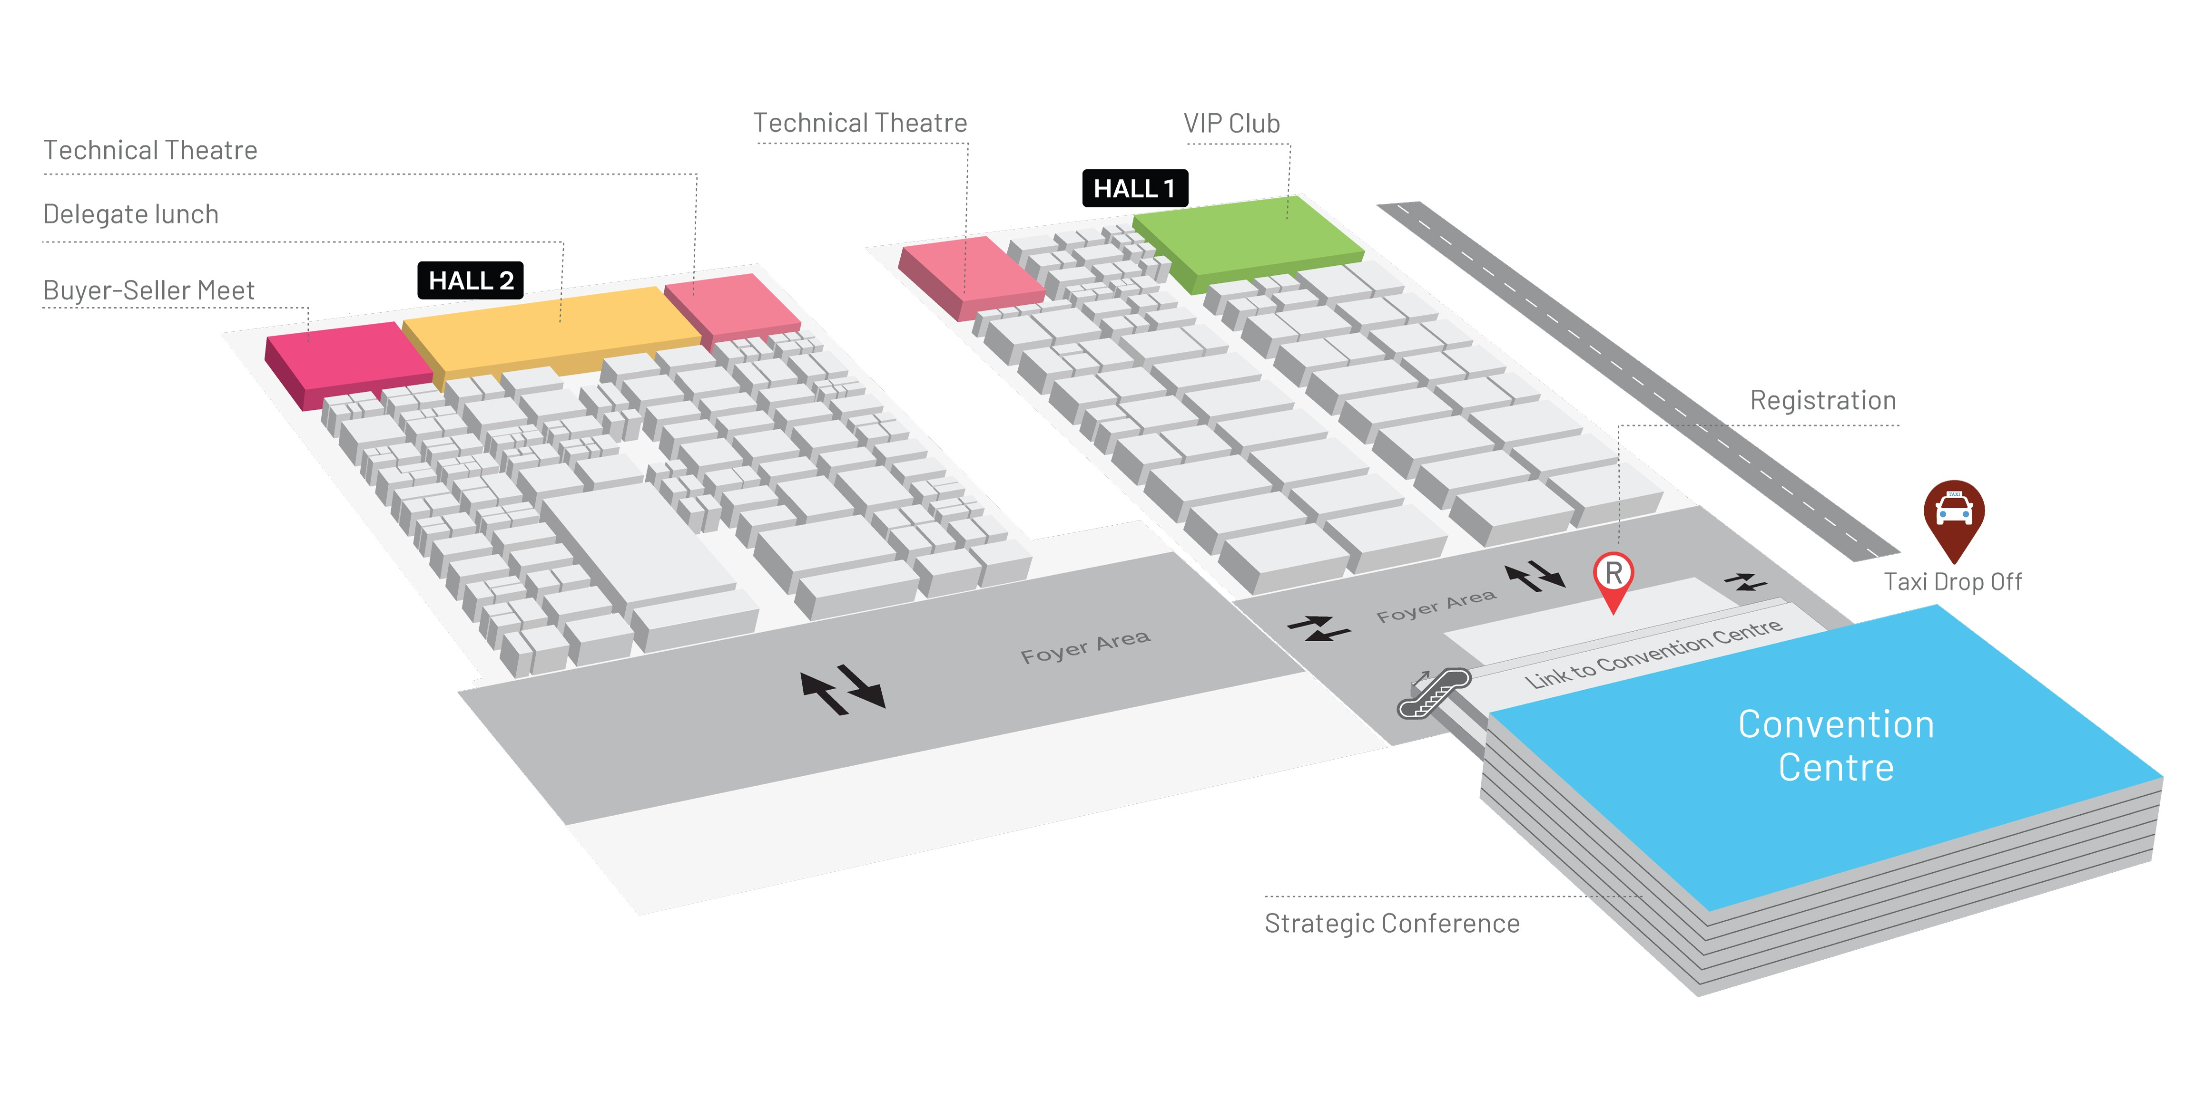
VENUE MAP
Set within the state-of-the-art Yashobhoomi exhibition and conference centre in New Delhi, the Bharat Electricity Summit will showcase 60,000 sqm of exhibition space across Halls 1 and 2, offering an expansive platform for industry participation.
The exhibition layout has been carefully curated to optimise visitor flow, enhance exhibitor visibility and create an immersive environment where companies can showcase their technologies, forge partnerships, and engage with key decision-makers from across the power and electricity value chain.

Slide 8
WHY EXHBIT
Position your brand at the forefront of global electricity transformation. Here’s why industry leaders from around the world choose to exhibit at Bharat Electricity Summit 2026.
JOIN A COUNTRY PAVILION
Showcase your national capabilities on a global stage. Exhibiting within a Country Pavilion elevates your visibility, strengthens bilateral trade links and connects you with Indian buyers seeking trusted international partners. Ideal for trade bodies, government delegations and export focused suppliers.
 | ACCESS DECISION-MAKERS Engage with global policymakers, procurement heads and public and private sector buyers driving electricity strategies across India and international markets.
 | SHOWCASE INNOVATION Position your products and services as critical enablers of secure, sustainable and scalable electricity systems.
 | GENERATE BUSINESS LEADS Connect with over 25,000 high-value attendees actively seeking partnerships, procurement and project solutions across the full electricity value chain.
 | UNLOCK INVESTMENT Tap into India’s vast public and private sector investment pipeline to accelerate your business growth.
 | DEMONSTRATE LEADERSHIP Strengthen your brand’s global presence as a trusted provider of solutions spanning conventional power, renewables, storage, digital grids and next-generation electricity systems.

Slide 9
THEMATIC ZONES
The Bharat Electricity Summit will play host to six thematic zones, designed to enable companies to demonstrate their flagship technologies and solutions within their most relevant area of the value chain. These zones will function as convergence points for the summit’s principal themes, facilitating engagement among industry stakeholders.
JOIN A COUNTRY PAVILION
Showcase your national capabilities on a global stage. Exhibiting within a Country Pavilion elevates your visibility, strengthens bilateral trade links and connects you with Indian buyers seeking trusted international partners. Ideal for trade bodies, government delegations and export focused suppliers.
THEMATIC ZONE | DESCRIPTION
Power Storage & E-Mobility Zone | Showcasing advanced storage systems, battery technologies and EV-charging innovations enabling grid stability, backup power and the expansion of electric mobility ecosystem. This zone brings together solution providers accelerating the shift towards a cleaner, smarter transportation future.
Renewable & Clean Energy Zone | A dedicated hub for solar, wind, hydro, biomass and green hydrogen technologies powering India’s clean energy transition. Exhibitors here will highlight scalable solutions and next-generation technologies driving low-carbon, sustainable and resilient electricity generation.
Transmission Zone | Focused on the infrastructure that powers long-distance electricity flow, this zone features transmission towers, conductors, substations, and high-voltage technologies essential to a reliable and modern grid. Ideal for those shaping the backbone of India’s power network.
Power Generation Zone | Where traditional and emerging power technologies converge — from turbines, boilers and generators to nuclear, hydrogen and other low-carbon systems. This zone showcases solutions unlocking higher efficiency, reliability and performance in electricity production.
Distribution & Smart Grid Zone | A showcase of cutting-edge distribution, metering, automation, and control technologies powering real-time, data-driven electricity delivery. This zone highlights smart grid solutions that improve efficiency, reduce losses, and enable a more connected and intelligent power ecosystem.
Energy Innovation & Start up Zone | A launchpad for disruptive ideas and breakthrough technologies, bringing together startups, R&D pioneers and digital innovators shaping the future of electricity. This is where next-gen solutions, bold thinking and new business models redefine the power sector.

Slide 10
WHO WILL YOU MEET
Engage with high-value decision-makers, manufacturers, suppliers, solution providers, buyers, innovators and influencers from across the global power supply chain.
GOVERNMENT LEADERS
PROJECT OWNERS & EPCs
INFRASTRUCTURE LEADERS
Ministers, senior officials and regulators from national and international electricity bodies and public sector institutions responsible for policy, procurement and project approvals.
Directors and project managers from developers and EPC firms managing large-scale power and grid infrastructure projects.
Executives and technical leads from power generation, transmission, and distribution companies seeking solutions to modernise infrastructure and improve efficiency.
QUALIFIED BUYERS
TECHNOLOGY & ENGINEERING LEADERS
FINANCIAL INSTITUTIONS
Procurement heads, purchasing managers and operations leaders from power, infrastructure and manufacturing sectors sourcing innovative solutions to improve efficiency and sustainability.
CTOs, R&D heads, engineers and digital experts driving the development and deployment of advanced technologies in AI, smart grids, forecasting, automation and next generation electricity systems partnerships.
Global investment directors, fund managers and PPP specialists from banks, private equity firms and infrastructure funds financing electricity transformation projects worldwide.
MSMEs & LARGE MANUFACTURERS
INDUSTRY & TRADE ASSOCIATIONS
ACADEMIA & RESEARCH
Business leaders, product heads and decisionmakers from micro, small and medium enterprises (MSMEs) and large manufacturers exploring partnerships, technologies and procurement opportunities across the electricity sector.
International chambers of commerce, export bodies, policy think tanks and sector advisors advocating industry growth and global cooperation across the electricity ecosystem.
Universities, global think tanks and innovation hubs driving collaboration on advanced R&D, emerging technologies and workforce readiness.

Slide 11
BUYER SELLER MEET
The Bharat Electricity Summit Buyer–Seller Meet is designed to accelerate partnerships and unlock new business opportunities across the global power supply chain. By facilitating pre-arranged, high-value meetings between qualified buyers and leading solution providers, the programme ensures meaningful engagement, efficient dealmaking, and maximum ROI — all under one roof.
JOIN A COUNTRY PAVILION
Showcase your national capabilities on a global stage. Exhibiting within a Country Pavilion elevates your visibility, strengthens bilateral trade links and connects you with Indian buyers seeking trusted international partners. Ideal for trade bodies, government delegations and export focused suppliers.
This exclusive initiative serves as a catalyst for business growth, enabling project developers, EPCs, MSMEs, policymakers, manufacturers, and investors to connect directly with global innovators, technology leaders, and solution providers driving the future of clean energy.
 | QUALIFIED BUYER ACCESS Meet directly with pre-screened, high-value global buyers actively sourcing solutions for current and upcoming projects.
 | ACCELERATED SALES CYCLE Engage decision-makers at the right time, in the right place — reducing sales lead times and maximising business outcomes.
 | ENHANCED VISIBILITY Stand out as a key partner in the global power and electricity transformation by participating in exclusive meetings.
 | ROI-DRIVEN PROGRAMME Convert conversations into contracts by connecting with buyers who are committed to sourcing new technologies, equipment, and services.

Slide 12
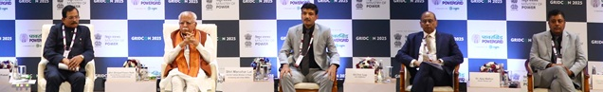
CONFERENCES
Bharat Electricity Summit accelerates India’s power sector evolution by convening global industry experts, regulators, policymakers and innovators to champion breakthroughs in power generation and distribution, grid upgrades and modernisation, renewable scaling and storage ecosystems, forging pathways to a robust and equitable energy landscape.
Dynamic keynotes, high-level discussions, expert forums, collaborative roundtables and interactive workshops deliver frontier insights across power value chain fueling progress through knowledge exchange and strategic alliances crucial for a sustainable, accessible and reliable energy future.
 | STRATEGIC CONFERENCE The Strategic Conference will unite ministers, policymakers, global CEOs and senior decision-makers from across the power and electricity sector. This high-level gathering is designed to drive India’s bold power future with solutions that resonate globally.
 | TECHNICAL CONFERENCE The Technical Conference will convene leading power sector professional including - scientists, engineers, academia and technology experts from around the world to showcase the advanced innovations that will drive sustainable, affordable and resilient future electricity systems.
 | LEADERSHIP ROUNDTABLES Invitation-only dialogue for the power sector’s most influential voices. These closed-door sessions convene government leaders, power sector executives, financiers and thought leaders to tackle strategic challenges and policy priorities driving long-term, transformative progress.

Slide 13
THANK YOU
19-22 March 2026 Yashobhoomi, Dwarka
New Delhi, India
SAVE THE DATE 19- 22 MARCH 2026
www.bharatelectricitysummit.com

